Slide 1

Strategic Challenge 2022
Phase 2 instructions

Slide 2
Agenda
Phase 2 assignment
Case for change & ambition output
Where to Play instructions
How to Win instructions
Roadmap & Enablers instructions

Slide 3

You received your second project assignment from your manager
Phase 2 assignment
From: Marina Ferrari
To: The Nature Conservancy case team
Subject: Phase 2 assignment
Hello team!
First of all, congratulations on the analysis of the expected land area destinated to agribusiness in Pará! AAG and I were truly impressed by the results of your model.
Moving forward, I need your support to finish the Strategy Plan framework for the entire case. This involves using the output of your model together with additional data to finish the Where to Play workstream, as well as advancing the thinking on the other workstreams.
I attached to this e-mail the main output of our project: the “Strategy on a page”. We have already completed the analysis on case for change & ambition (you can go through the back-ups to understand what we did there). Your goal is to complete the framework for the remaining workstreams and create 4 back-up slides: one for Where to Play, one for How to Win and two for Implementation Roadmap & Enablers (including the timeline).
You will also need to present these slides to the client in the final meeting of the project. You should prepare an 8 to 10min presentation and allow 5min to answer any questions they might have. The slides must be in English, but you can decide whether you prefer to present in English, Spanish or Portuguese.
I asked for the other consultants of our team to send you detailed instructions & data for each of the workstreams.
Once again, time is short, so I strongly recommend that you divide the work. But remember: the workstreams depend on each other, so make sure you come up with a unified answer to create the Strategic Plan for TNC on how to mitigate the environmental impact of agriculture and livestock in the state of Pará.
Thanks a lot, team, and good luck!
Best,
Marina

Slide 4
The goal of Phase 2 is to complete the “Strategy on a page” slide
Case for change: Why do we need to mitigate the environmental impact of agribusiness in the Amazon region of Brazil?
Brazil is among the largest greenhouse gases emitters, largely due to deforestation
The Brazilian Amazon is at risk: about 20% of the forest has already disappeared, largely because of the expansion of agribusiness, logging and infrastructure
Livestock is related to more than 90% of deforestation in the Amazon
Challenge to combine economic production, environmental protection and the promotion of local development while combating climate change
Ambition
Reduce 60% of the equivalent carbon emissions (CO2e) of the state of Pará by 2030, both in terms of agribusiness and deforestation emissions
Short term ambition (2019-22): Reduce 10% (12M Ton) of CO2e emissions vs 2019 baseline
Mid term ambition (2023-26): Reduce 30% (36M Ton) of CO2e emissions vs 2019 baseline
Long term ambition (2027-30): Reduce 60% (73M Ton) of CO2e emissions vs 2019 baseline
Where to play
How to win
To be completed
To be completed
Implementation roadmap
To be completed
Enablers
To be completed

Slide 5
Strategic Plan Framework & Key questions
Case for change
Why do we need to mitigate the environmental impact of agriculture and livestock in the Amazon region of Brazil?
Which problem statement are we trying to solve?
Ambition
What is the ambition of the plan in Pará, in terms of equivalent carbon emissions reduction?
How to deliver the forecasted demand for agriculture and livestock while minimizing equivalent carbon emissions?
In what time frame should the project capture this ambition?
Where to play
How to win
Which combinations of region + agribusiness product should be prioritized? These are priority areas to invest
Which regions are most likely to increase the area devoted to agriculture and livestock?
Which regions have the highest deforestation rate?
Which regions have the lowest productivity?
Which products (types of crops and livestock) have the highest environmental footprint?
What are the ways to mitigate the environmental impact of agriculture and livestock in Brazil?
Implementation roadmap
What is the implementation roadmap of the strategic plan?
Which set of initiatives are global (applied to all regions & products) vs specific (applied to a specific region, product and/or rural property size)?
How does each initiative contribute to reach the project’s ambition?
How to monitor the effectiveness of the proposed plan? What are the project’s success indicators (KPIs)?
Enablers
What are the most relevant enablers to ensure a successful implementation of the strategic initiatives?

Slide 6
Where to Play back-up
Placeholder for back-ups

Slide 7
How to Win back-up
Placeholder for back-ups

Slide 8
Roadmap & Enablers back-up (1/2)
Placeholder for back-ups

Slide 9
Roadmap & Enablers back-up (2/2)
Placeholder for back-ups

Slide 10
Agenda
Phase 2 assignment
Case for change & ambition output
Where to Play instructions
How to Win instructions
Roadmap & Enablers instructions

Slide 11
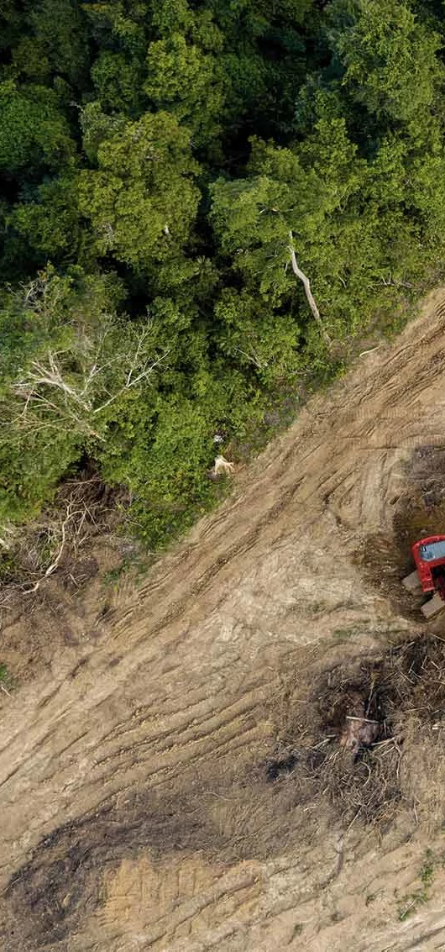
Case for change
Case for change
Situation
Climate change: Large emitters of greenhouse gases, such as Brazil and the other G20 countries, are responsible for most of the emission reduction needed to meet the Paris Agreement objective of stabilizing the global warming at 1.5°C this century. However, Brazil is on the opposite path: greenhouse gases emissions have been rising, largely due to deforestation, and current national goals under discussions lead us to the +2.7°C level. Therefore, it is crucial to increase the ambition of mitigation actions (reduction of emissions) to avoid the worst effects of climate change on the planet.
Amazon: With almost 7M Km², spread over 9 countries, the Amazon rainforest plays a fundamental role in the stability of the climate and rainfall. The forest is home for more than 40K species of plants, 4700 species of animals, as well as about 14 million urban and rural families and 180 ethnic groups of Indigenous people in Brazil. It is also the region that concentrates 1/5 of the world's fresh water. Today, Indigenous Lands and Conservation Units cover more than 42% of the Brazilian Amazon and, according to the forest code, landowners can only use up to 20% of their property, reserving the remaining 80% as legal reserves for nature conservation.
TNC: The Nature Conservancy (TNC) is a global organization dedicated to protecting the lands and waters on which all life depends. Guided by science, TNC creates innovative local solutions to the world's top challenges so that nature and people can thrive together. In Brazil, where it has been operating for over 30 years, TNC's work focuses on solving the complex conservation challenges of the Amazon, Cerrado and Atlantic Forest to reverse climate change and the loss of biodiversity.
Complication
The Brazilian Amazon is at risk: about 20% of the forest has already disappeared, largely because of the expansion of agribusiness, logging and infrastructure. The state of Pará alone concentrated 46% of the deforestation in the Brazilian Amazon in 2020.
In addition, the Amazon region accounts for around 80% of total equivalent CO2 emissions related to deforestation in Brazil
Livestock is, historically, the largest responsible for deforestation in the country, being directly related to more than 90% of deforestation in the Amazon and 70% in the Cerrado. It is commonly the first economic activity in a newly deforested area.
It is common for soybeans to occupy old Amazonian pastures through the recovery of the soil with the use of technology.
The compatibility between economic production, environmental protection and the promotion of local development is a great challenge for the conservation of the Amazon and to combat climate change
TNC is addressing these pressing challenges, and to help with that, asked for our support to develop a strategic plan to mitigate the climate impact of agriculture and livestock in the Amazon region of Brazil
Source: Bain Strategic Challenge – all data has been solely designed to match the solution of this case

Slide 12
Our ambition is to reduce by 60% the liquid emissions of CO2e in Pará by 2030
ambition
Equivalent carbon emissions (CO2e) baseline and expected reduction in Pará by sector
(M Tons of CO2e)
Sector details
Deforestation
The process of deforestation, which generates the decomposition of organic matter in the soil, together with forest fires increase greenhouse gas emissions.
CO2e removals refer to protected native forests, reforestation initiatives and secondary vegetation growth
Agribusiness
Emissions related to farming activities, livestock gases, soil management etc.
Does not include CO2e from industry, energy and waste sectors (5% of total)
Source: Bain Strategic Challenge – all data has been solely designed to match the solution of this case

Slide 13
Back-up: Our ambition is measured in terms of liquid CO2e emissions
ambition
Gross emissions reductions
CO2e removals increase
Final liquid emissions
Gross emissions
CO2e removals
Liquid emissions
Description
Total emissions of greenhouse gases
Measured in equivalent carbon emissions (unit designed to represent all greenhouse gases)
Conditions that capture carbon from the atmosphere, reducing CO2e impact on the planet
Examples are protected areas of native forests, reforestation initiatives and secondary vegetation growth
Defined as the difference between gross emissions and CO2e removals
The plan’s strategic initiatives should be able to reduce the total gross CO2e emissions in the sectors considered:
Agribusiness: 60% reduction vs 2019 baseline
Deforestation: 30% reduction vs 2019 baseline
Note: remaining 30% accounted for in removals increase
The plan’s strategic initiatives should be able to increase CO2e removals, further reducing the total liquid emissions in the baseline
End-state goal of the plan by 2030, accounting for the impact of the plan’s strategic initiatives
60% reduction target in 2030 was set based on Pará government’s plan to be zero carbon by 2036
Source: Bain Strategic Challenge – all data has been solely designed to match the solution of this case

Slide 14
There is an expected ramp up to capture the full potential of our plan over time
ambition
Equivalent carbon emissions (CO2e) expected reduction in Pará by impact type
(M Tons of CO2e)
It is expected that some initiatives might take longer to impact CO2e emissions, so most of the gains come in the long term
Source: Bain Strategic Challenge – all data has been solely designed to match the solution of this case

Slide 15
Agenda
Phase 2 assignment
Case for change & ambition output
Where to Play instructions
How to Win instructions
Roadmap & Enablers instructions

Slide 16
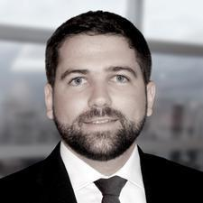
You received an e-mail from the consultant leading the Where to Play workstream
Where to play
From: Pedro Herig
To: The Nature Conservancy case team
Subject: Where to Play instructions
Hi team!
I was very impressed by the predictive model you created about the land area for agribusiness! Well done!
Marina asked to me to send additional details on the Where to Play workstream. Our specific goal is to prioritize 4 combinations of region & product to help TNC invest its resources on the most critical areas in terms of potential environmental impact.
As mentioned before, we are using 4 criteria to perform this analysis: 1. expected land area, 2. deforestation rate, 3. productivity and 4. product ranking (environmental footprint). Now I am sending you some additional data and some tips to help you on this workstream:
Additional data:
I received additional databases from our Research & Data Services team with the information for the last 3 criteria:
Historical deforestation area between 2017-19 by city in Pará (for the criteria 2)
Database with the value (R$ thousands) of produced items by product and by city in Pará for 2019 (for the criteria 3)
A slide with the environmental footprint ranking by product type (for the criteria 4)
Useful tips:
When we think about the combination of region + product, we want to make sure that TNC knows exactly where to focus. For example, we might find that a specific type of crop in a certain city in Pará has a big potential to impact the environment, so TNC will need to address this area first to achieve the strategic plan’s ambition.
I know you modeled the expected land area by city, but in order to make this prioritization I recommend you work by microregion. Basically, a microregion is a combination of cities next to each other. I am sending you an Excel file (“City to microregion”) with the list of all cities and microregions in the state of Pará.
In terms of agribusiness products, you can stick to the granularity available in your land area database (pasture, soy, cassava, corn, cocoa, palm oil, açaí, rice, beans, sorghum and others).
For criteria 2, my contact at TNC suggested we use the average of deforestation rates between 2017 and 2019. Therefore, you should first calculate the deforestation rate (deforestation area divided by total area) for each microregion for each year, and then calculate the simple average of deforestation rates among these 3 years for each microregion.
For criteria 3, you can calculate productivity as “total R$ k produced” divided by “total destinated area” in 2019 for each combination of microregion + product.
Finally, I have an e-mail with orientations from the Partner on how to create a prioritization matrix. This tool will be important to combine all the 4 criteria we are using and arrive on the short list of prioritized areas (microregion + product).
Best regards,
Pedro

Slide 17

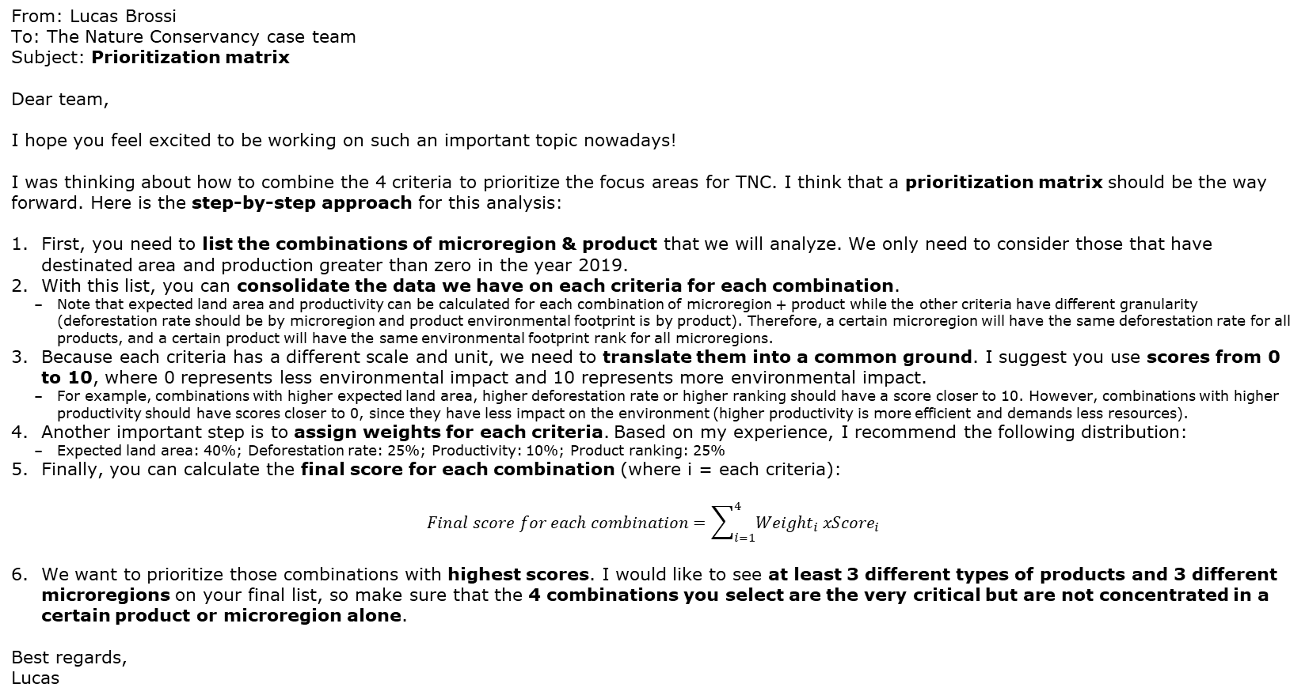
The Bain Partner explained to you how to do a prioritization matrix
Where to play
From: Lucas Brossi
To: The Nature Conservancy case team
Subject: Prioritization matrix
Dear team,
I hope you feel excited to be working on such an important topic nowadays!
I was thinking about how to combine the 4 criteria to prioritize the focus areas for TNC. I think that a prioritization matrix should be the way forward. Here is the step-by-step approach for this analysis:
First, you need to list the combinations of microregion & product that we will analyze. We only need to consider those that have destinated area and production greater than zero in the year 2019.
With this list, you can consolidate the data we have on each criteria for each combination.
Note that expected land area and productivity can be calculated for each combination of microregion + product while the other criteria have different granularity (deforestation rate should be by microregion and product environmental footprint is by product). Therefore, a certain microregion will have the same deforestation rate for all products, and a certain product will have the same environmental footprint rank for all microregions.
Because each criteria has a different scale and unit, we need to translate them into a common ground. I suggest you use scores from 0 to 10, where 0 represents less environmental impact and 10 represents more environmental impact.
For example, combinations with higher expected land area, higher deforestation rate or higher ranking should have a score closer to 10. However, combinations with higher productivity should have scores closer to 0, since they have less impact on the environment (higher productivity is more efficient and demands less resources).
Another important step is to assign weights for each criteria. Based on my experience, I recommend the following distribution:
Expected land area: 40%; Deforestation rate: 25%; Productivity: 10%; Product ranking: 25%
Finally, you can calculate the final score for each combination (where i = each criteria):
$$Final score for each combination=\sum_{i=1}^{4}{{Weight}_{i} x{Score}_{i}}$$
We want to prioritize those combinations with highest scores. I would like to see at least 3 different types of products and 3 different microregions on your final list, so make sure that the 4 combinations you select are the very critical but are not concentrated in a certain product or microregion alone.
Best regards,
Lucas

Slide 18
It is possible to group products in the agribusiness sector according to their environmental footprints
Where to play
Ranking of environmental footprint by agribusiness product group
(5 = highest impact; 1 = lowest impact)
Group | Description | Agribusiness products (not exhaustive) | Ranking
A | Higher scale, non-native products with significant impact on the environment | Livestock, soy | 5
B | Higher scale, non-native products | Sorghum, corn | 4
C | Lower scale, subsistence products | Beans, cassava, rice | 3
D | Variety of other products (e.g., banana, orange, papaya etc.) | Others | 2
E | Regional products, typical of agroforestry systems | Palm oil, açaí, cocoa | 1
Source: Bain Strategic Challenge – all data has been solely designed to match the solution of this case

Slide 19
Agenda
Phase 2 assignment
Case for change & ambition output
Where to Play instructions
How to Win instructions
Roadmap & Enablers instructions

Slide 20

You received an e-mail from the consultant leading the How to Win workstream
How to Win
From: Lucas Cardoso
To: The Nature Conservancy case team
Subject: How to Win instructions
Hello team! How are you?
Thank you in advance for the help on the How to Win workstream! I am sending you some additional instructions to finalize this workstream leveraging some of the pre-work I did over the last days.
Our specific goal is to list 3 key levers to mitigate the environmental impact of agriculture and livestock in the Amazon region (specifically in the state of Pará), which will help TNC accomplish the plan’s ambition.
You will find attached to this e-mail my notes from an expert interview I did yesterday. I talked to one of TNC’s leaders in conservation in the Amazon region, and she highlighted some of the key challenges the region is facing today.
In addition, you will find a news clipping that I received from our Research & Data Services team with the most important news regarding climate impact mitigation in the Amazon and current initiatives to promote the sustainable development of the region.
Best,
Lucas

Slide 21

Expert interview
overall_1_132314632311698956 columns_1_132314632311698956 22_1_132314659677251034 25_1_132314660769011946 26_1_132314693803240420
How to Win
“
The growth of Brazilian agriculture is linked to the occupation of new areas, through the expansion of grain plantations to the northern region of the country (e.g., in the Amazon), in a process that is conventionally called as the advance of the agricultural frontier.
”
“
Livestock is, historically, the largest responsible for deforestation in Brazil, being directly related to more than 90% of deforestation in the Amazon and 70% in the Cerrado. It is commonly the first economic activity in a newly deforested area. Almost 40% of the country's beef production is found in the Amazon. It is common for soybeans to occupy old Amazonian pastures through the recovery of the soil with the use of technology. In general, livestock is responsible for opening new lands to agriculture.
”
“
The expansion of deforestation is not always linked to the increase in economic production from the agribusiness sector, with newly opened areas with very low productivity. Several researchers indicate that factors linked to the land market and disputes over land should be considered — especially in regions of agricultural and livestock expansion, where land speculation and land grabbing occur more intensively.
”
“
Between 2008 and 2019, 58% to 70% of deforestation in the Amazon occurred inside rural properties. Contrary to the widespread perception that deforestation is practiced over large areas and is concentrated mainly on large farms, there is an important part of the loss of forest cover that, individually, is almost invisible: the so-called social deforestation linked to family farming in small rural properties.
”
Source: Bain Strategic Challenge – all data has been solely designed to match the solution of this case

Slide 22

News clipping
overall_0_132316346373191685 columns_2_132316346318560303 6_1_132316346334084450 9_1_132316346334194166 15_1_132316346387369444 19_1_132316348817544033
How to Win
Clipping on climate impact mitigation (1/2)
Clipping on climate impact mitigation (2/2)
CompreRural.com, February 25th, 2022 ABC Plan: Study demonstrates socioeconomic impact A public policy that promotes the reduction of greenhouse gas emissions in agriculture, the ABC Plan (“Low-carbon Agriculture” Plan) comprises 7 technologies: recuperation of degraded pastures, crop-livestock-forest integration; no-till farming; biological nitrogen fixation; planted forests; treatment of animal waste; and adaptation to climate change. Between 2010 and 2020, the ABC Plan mitigated about 170 million tons of carbon dioxide equivalent in an area of 52 million hectares.
[…] The Plan offers a line of credit with a subsidized interest rate to finance investments in technologies and production systems that contribute to promoting an agricultural activity that is more adapted to climate change and mitigates greenhouse gases.
[…] the sustainable intensification of production requires a more qualified workforce, so public policies are needed to promote the qualification of those workers who were already employed in extensive model systems.
[…] The second stage of the ABC Plan added irrigation as a technology for sustainable production in Brazilian agriculture. The goal is to reduce the carbon equivalent emission by 1.1 billion tons in the agricultural sector in an area of 73 million hectares by 2030.
CicloVivo.com.br, February 15th, 2022 Restoring 10% of degraded areas in the Amazon could generate R$132 billion […] with the prioritized restoration of the Amazon, about 2.6 billion tons of Co2 would be removed from the atmosphere. “If you commercialize this potential carbon credit coming from these areas, for example, you have a scenario that is good for many things. In other words, you generate revenue from the carbon obtained from restoration”, explains Strassburg, who is executive director of the International Institute for Sustainability (IIS). He also argues that it is possible to use this money for the benefit of the forest, financing sustainable development programs.
OLiberal.com, March 12th, 2022 Amazon rainforest: nature in the fight against climate change Combining income generation for the community, diversity of plant species, return of fauna, soil improvement and, consequently, carbon capture, the recovery of forests via agroforestry systems (SAFs) has been one of the main opportunities to achieve the goal of forest recovery and support the region's sustainable development.
SAFs are mixed plantations of forest and agricultural species that can represent investments with a positive socio-environmental impact as a strategy to promote local development and forest recovery.
Source: Bain Strategic Challenge – all data has been solely designed to match the solution of this case

Slide 23
Agenda
Phase 2 assignment
Case for change & ambition output
Where to Play instructions
How to Win instructions
Roadmap & Enablers instructions

Slide 24

You received an e-mail from the Senior Associate Consultant leading the Roadmap & Enablers workstream
Roadmap & enablers
From: Enrico Menezes
To: The Nature Conservancy case team
Subject: Roadmap & Enablers instructions
Hi team,
It is a pleasure to be working with you on the Roadmap & Enablers workstream!
This workstream is segmented into 2 main tasks:
Create an implementation roadmap
The specific goal is to define 2-4 main strategic initiatives for each of the three “How to Win” levers that you defined previously. TNC will need to execute these activities to implement the proposed strategic plan.
When creating an implementation roadmap, it is also important to map the key performance indicators (KPIs) that you will use to monitor the effectiveness of the proposed plan. Each strategic initiative that you define should have 1 or 2 KPIs to measure its results.
It is also important to assess how each initiative contribute to reach the plan’s ambition (CO2e reduction). I attached a 2x2 matrix (Impact to CO2e emissions vs ease of implementation) to help you perform this assessment. There is no need to quantify each initiative in terms of CO2e emissions. You just have to define a harvey ball representing the contribution level of each initiative to reach the ambition.
You can think of the output of this roadmap as follows (example):
Keep in mind that some of this initiatives might be applied to all regions while others could be specific (to a certain prioritized area or depending on the rural property size from its target).
Finally, some initiatives will need to be executed first, while others can start a later stage – it’s important to define an execution timeline for them. I also attached a timeline template that you can use to sequence your initiatives (this timeline does not need to be on the “Strategy on a page” slide that you are doing).
Map the key enablers to ensure a successful implementation
One enabler is an activity or topic that must exist or be developed to ensure that all the activities of the proposed roadmap are performed well and deliver the expected result
The specific goal is to define 4-6 enablers for our proposed Strategic Plan
I attached some thoughts that our Manager and Partner shared with me earlier this week about this workstream that might help you!
Best regards,
Enrico
Initiative | KPI | Contrib. level
ABC | XYZ (unit: R$/hectare)

Slide 25
You can assess the contribution of each initiative to reach the ambition by placing it on a 2x2 matrix
overall_1_131638052501531432 columns_2_131638052746411566
Roadmap & enablers
By placing an initiative on the matrix, you can select the Harvey ball that represents its contribution to reach the ambition
Think about different components when placing an initiative on the matrix
Y-axis: Impact to CO2 emissions
Impact to CO2e emissions
Does the initiative contribute directly to CO2e emissions reduction?
Or does the initiative have an indirect impact on CO2e?
Does the initiative affect a large area/region?
Or is the initiative specific to a region/product?
+
+
-
+
-
Ease of implementation
Do many stakeholders need to be mobilized to implement the initiative?
Is there a low cost to implement the initiative?
Does the initiative disrupt current activities or processes in the region?
-
+
-
-
Harvey ball legend
-
X-axis: Ease of implementation
+
Light contribution to reach ambition
Strong contribution to reach ambition

Slide 26
Timeline template
Roadmap & enablers
Short term
2019-2022
Mid term
2023-2026
Long term
2027-2030

Slide 27
Your manager shared some thoughts on how to group the implementation initiatives
Roadmap & enablers
From: Marina Ferrari
To: The Nature Conservancy case team
Subject: Ideas to group the implementation initiatives
Hi team, how are you?
After all the hard work on the Where to Play and How to Win workstreams, we need to translate our insights into actionable recommendations for TNC. That is why the implementation roadmap is a critical part of our project.
I have also put in some thoughts on this workstream, and I think some of them might help you.
Once you breakdown each How to Win lever into its 2-4 strategic initiatives, I would try to understand the scope of each initiative to present them in a logical way on the “Strategy on a page” slide.
The first group will comprise cross-region initiatives: these are initiatives that are applied for all regions and/or products and are independent of the prioritization we did on Where to Play. You might find, for example, that one initiative to deal with an issue in one microregion can be applied in the same way for all other microregions.
The second group are initiatives that depend on the property size. You might have read so far that the solutions for large rural properties are very different from those for smallholder farmers. Try to think using this lens as well when analyzing your list of initiatives.
Finally, the third group are initiatives specific to the priority areas of the Where to Play workstream. This initiatives will help solve specific problems of this areas, such as rising deforestation rates or low productivity levels. This will be the first set of initiatives that TNC will execute when we deliver the plan to them.
Best regards,
Marina

Slide 28
The Bain partner on the case provided some guidelines on how to define enablers for this project
Roadmap & enablers
From: Lucas Brossi
To: The Nature Conservancy case team
Subject: Additional guidelines for the roadmap & enablers workstream
Hello team!
Here are some of my thoughts on the Enablers part of our project with TNC.
There are some activities related to the conservation of the environment that might be out of TNC’s scope of work. However, this activities are critical for the success of our plan.
I thought about activities performed by the government, law enforcement & surveillance agencies, agricultural research institutions etc. You can think about which of those activities are the most critical enablers for our Strategic Plan.
For example, we have been using databases regarding area devoted to agriculture, productivity and deforestation rates. We need to make sure this data is updated regularly by other agencies to track the success of our plan.
In addition, there some additional commitments from the private sector that may also play an important enabler role on our plan. I heard about the soy moratorium in Brazil – you might want to investigate that as well.
Best regards,
Lucas

